Slide 1

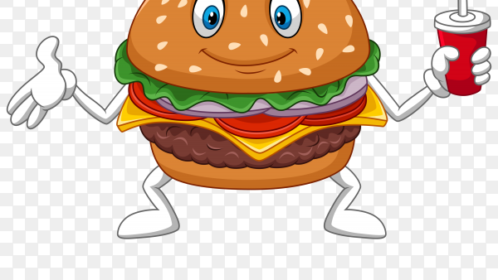

Great Wolf Resorts BURGERS
TEST PLANNING
Falomy Eugene, Mahmoud Ahmad ​

Slide 2
Scenario 1

Slide 3
Research Question: How did the change in burger price influence the customer decision and buying behavior of burgers at Great World Resort
Test Idea: Test if a controlled increase of burger prices will affect burger sales(Revenue) (Simple Paired Test)
Response Variable: revenue ( Quantity*Price) of burgers sold in all locations for the time period the test is conducted
Hypothesis: Increasing the price of a burger by 10% will increase the burger sales revenue because the adjustment in price won’t affect the demand or perception of burger worthiness by customer ( value-based pricing?)
Factors/Levels
Sales Date (Month)
Aggregated months (January-December)
Price
Different Values of the Price Factor
Property
Property Locations in different geographical areas

Slide 4
Methodology
Test Design
Sample Selection
Using Market Matching to match markets and create both the Test and the Control groups
Choose the best correlated market pairs
apply the 2T Test formula to estimate the statistical power of the test
Grouping properties based on burgers sales and Aggregate data on monthly basis
Exclude pizza sales, and properties with less than 12 months data

Slide 5
Average Monthly Burger Revenue by Paired Markets​
Test Market​ | Revenue​ | Control Market​ | Revenue​
Atlanta​ | $ 34,127 ​ | Grand Mound​ | $ 32,622 ​
Colorado Springs​ | $ 13,774 ​ | Sandusky​ | $ 13,406 ​
Concord​ | $ 18,674 ​ | Grapevine​ | $ 21,569 ​
Mason Family Resorts​ | $ 21,666 ​ | Scottsdale​ | $ 29,896 ​
Minnesota​ | $ 13,927 ​ | Poconos​ | $ 17,552 ​
Kansas City​ | $ 12,317 ​ | Williamsburg​ | $ 9,132 ​
* Table of Test & Control Groups and their average monthly sales

Slide 6
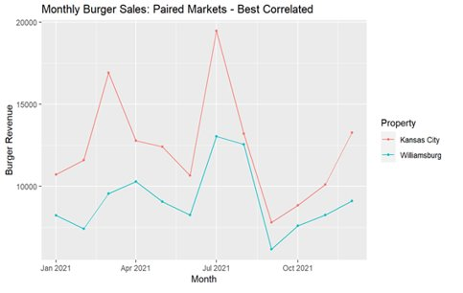
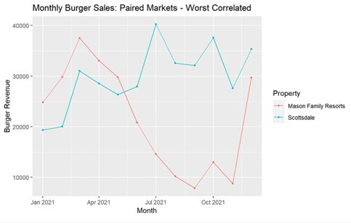
Test vs. control Market Trends
* Refer to Appendix for plots
Best correlated pairs: Kansas City vs. Williamsburg
Worst correlated pairs: Mason Family Resorts vs. Scottsdale
We notice that Kansas City and Williamsburg are the best correlated test and control group. There is close similarity when looking at monthly burger revenue trends However, they have lower Volume within the pairs, but they are worth choosing given their correlation. ​
We also thought that the worst correlated test and control group’s (Mason and Scottsdale) was worth mentioning. The pair has the second highest volume when looking at revenue, but the pairs are least correlated within the 6 pairs​

Slide 7
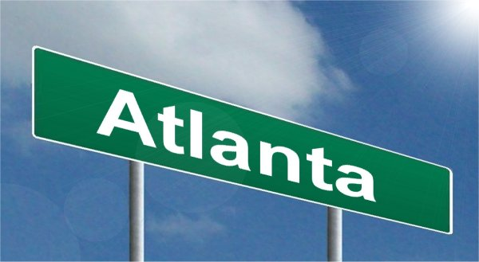



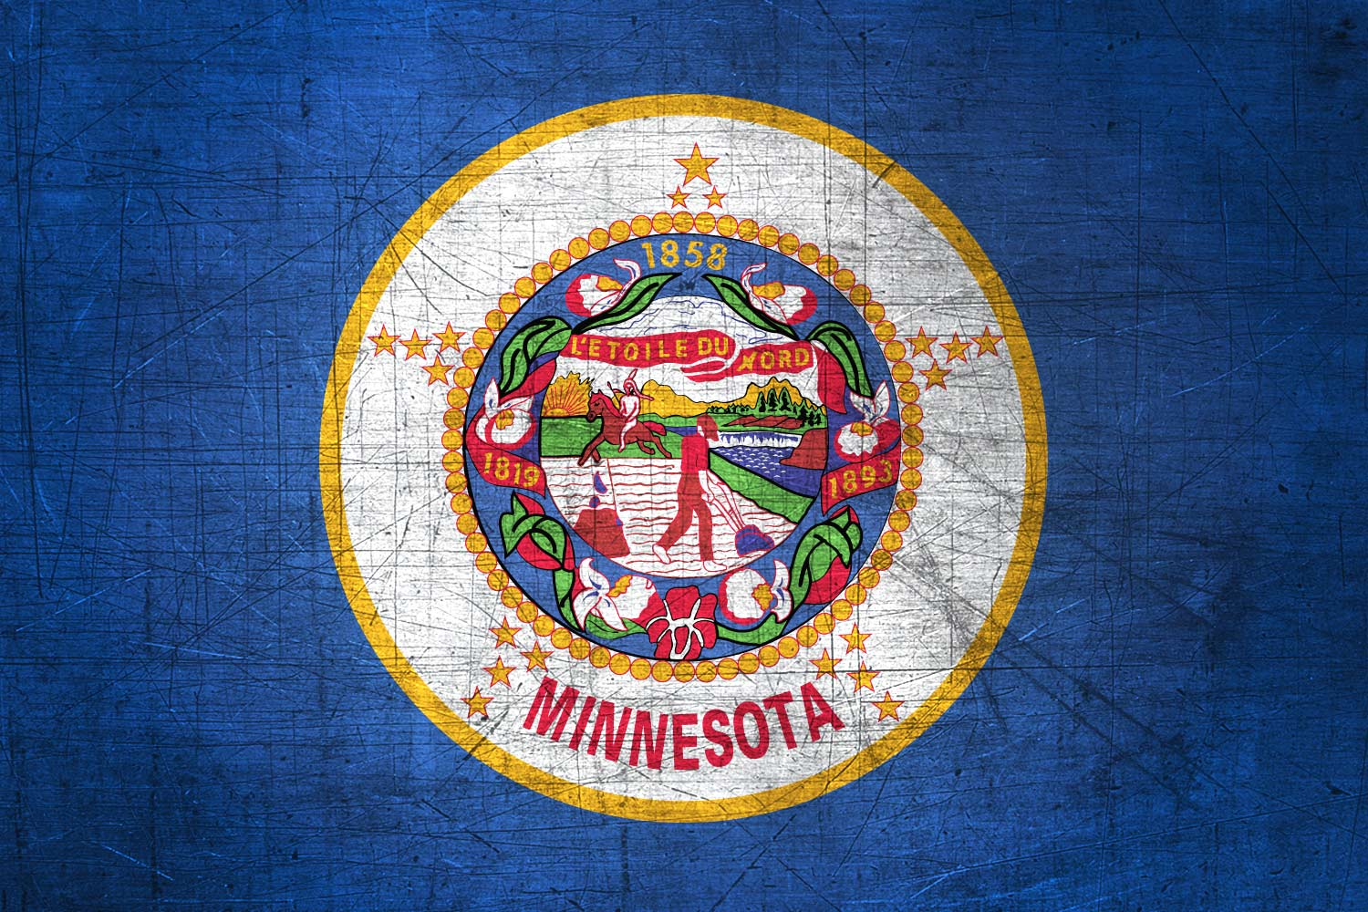
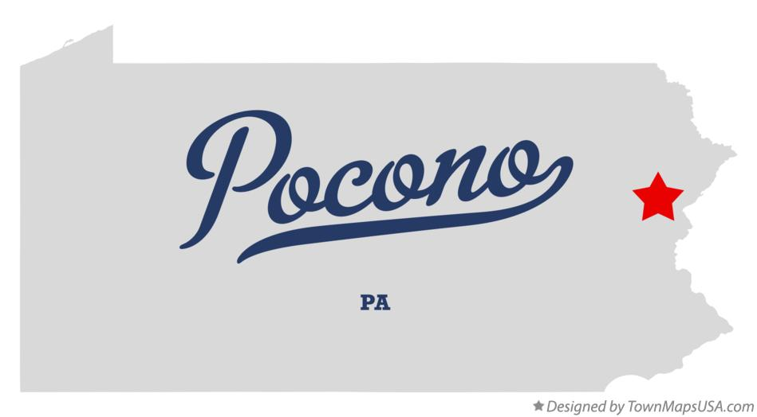
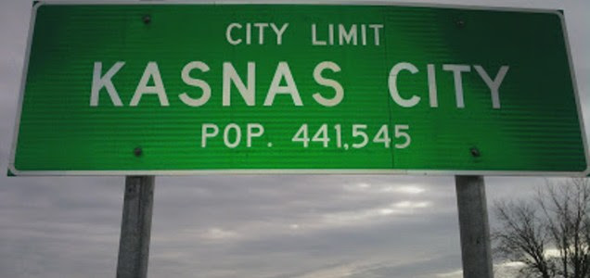

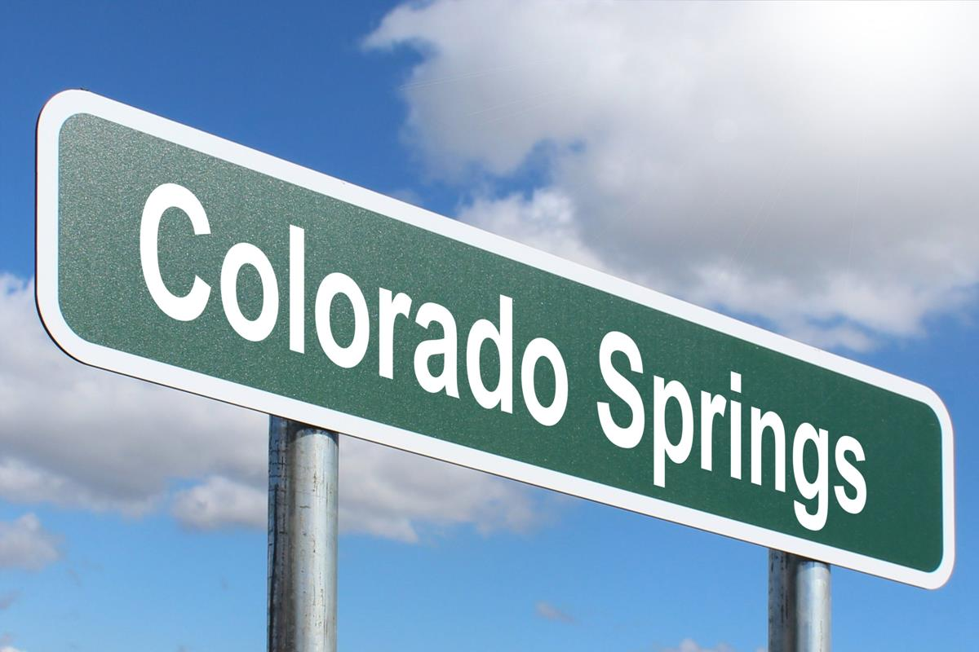


Property pairing
Power=0.1107
n= 6
Sig-level=0.05
average-revenue
=19163.22
Sd-Revenue
=9849.829
d=average-revenue*0.1
=1916.322
Test Group
Control Group
* Refer to Appendix for R Output
Exclude pairs with negative correlation
Assuming a 95% confidence, and 10% increase in burger Revenue, the power of the test is 0.1107
Use revenue of burger market to determine a similar property for testing
Mason Family Resorts

Slide 8

Timeline
Execution
End
02
5
Feb
2022
March 2022
April 1
2022
May 2022
W1
W2
W3
W4
W1
W2
W3
W4
W1
W2
W3
W4
W1
W2
W3
W4
1
03
01
4
Analysis
Dissemination
Implementation
Short Description
Short Description

Slide 9
Scenario 2

Slide 10
Research Question: What is the effect of different burger price points in Atlanta, for lunch, dinner, and different days of the week on sales revenue
Hypothesis: Increasing the price of a burgers during Dinner time on weekdays will increase the burger sales revenue
Test idea: Test if a change in burger price on different days of the week and different mealtime has an effect on sales revenue (ANOVA)
Response Variable: revenue ( Quantity*Price) of burgers
Factors/Levels
Days of the week
Weekdays(Mon-Thur) – Weekends(Frid-Sun)
Price
Meal-Time
Lunch -Dinner
0.00 difference, $0.25 price increase, $0.50 price increase, $0.75 price increase

Slide 11








Factors-Levels
Weekday
Weekend
price1
price2
price3
price4
Lunch
Dinner

Slide 12
Assumptions & Calculations
# of Treatments = ng
Sample Size output = n
16
178
Minimum needed sample size = 3
Assume medium effect size f = 0.25
Assume Power = 80% & confidence Interval = 0.05
# of Replicates/cell=n/ng=
178/16= 12 Replicates
if we have three replicates per treatment per week, how long would it take to run this test?​
# of Replicates/cell Replicates/treatment = 12/3 = 4
It would take 4 weeks to run the test!​

Slide 13
Timeline
Execution
End
02
5
Feb
2022
March 2022
April 1
2022
May 2022
W1
W2
W3
W4
W1
W2
W3
W4
W1
W2
W3
W4
W1
W2
W3
W4
1
03
4
01
Implementation
Analysis
Dissemination
Short Description
Short Description

Slide 14
Appendix

Slide 15
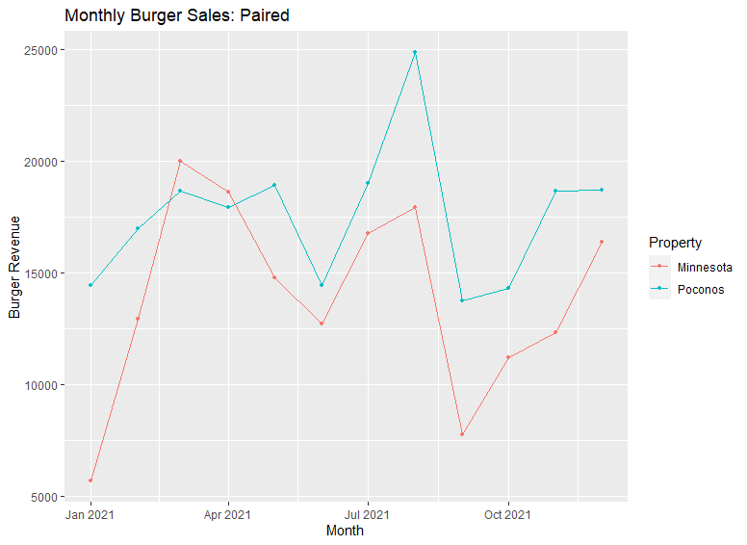
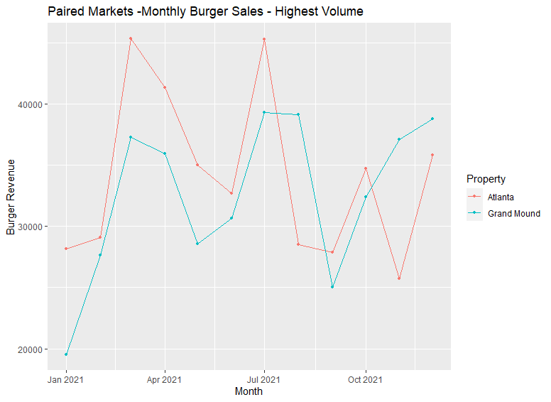
Other paired graphs

Slide 16
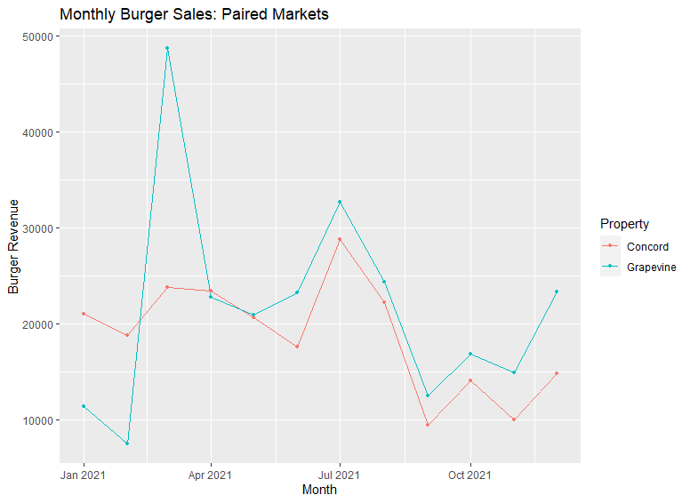
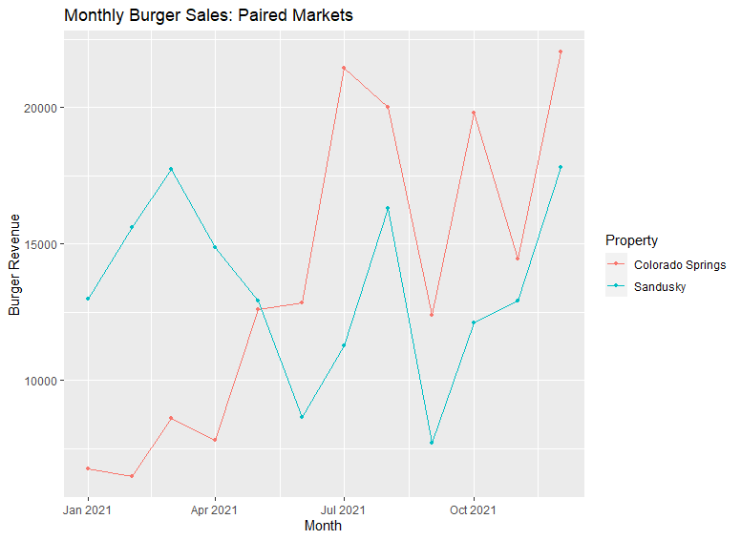
Other paired graphs

Slide 17
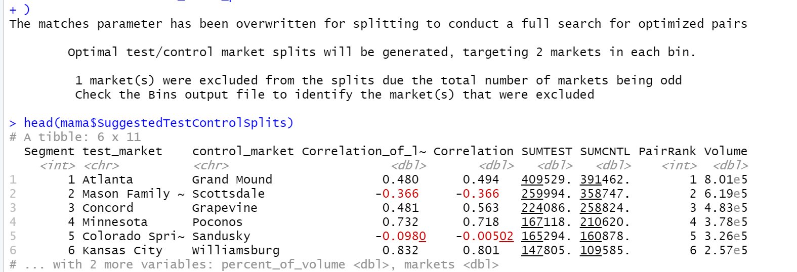
Market Pairing Output

Slide 18
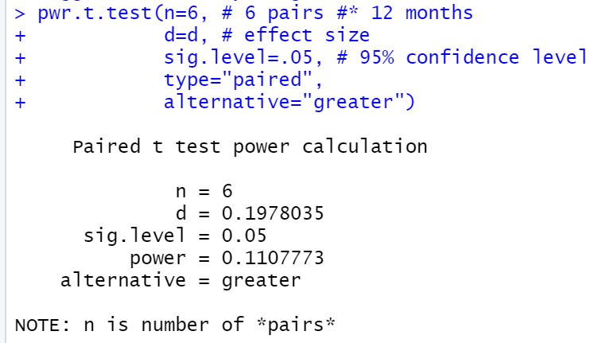
Power Test R output

Slide 19
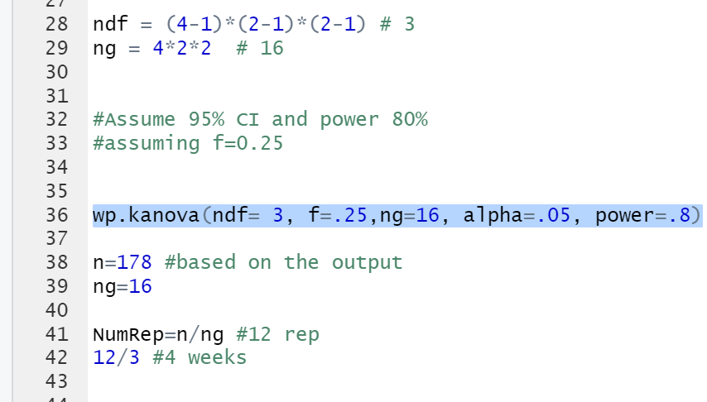
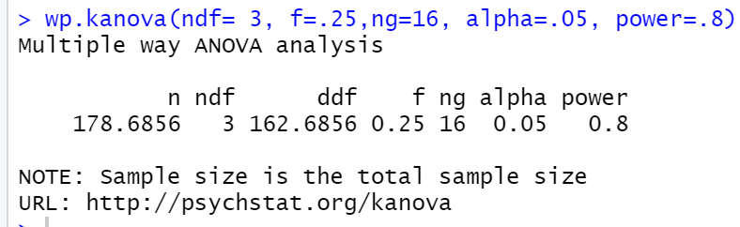
R output for Factorial test/ Anova

